Slide 1

Hotel booking analysis
Prepared By:-
Ayush Khetan

Slide 2
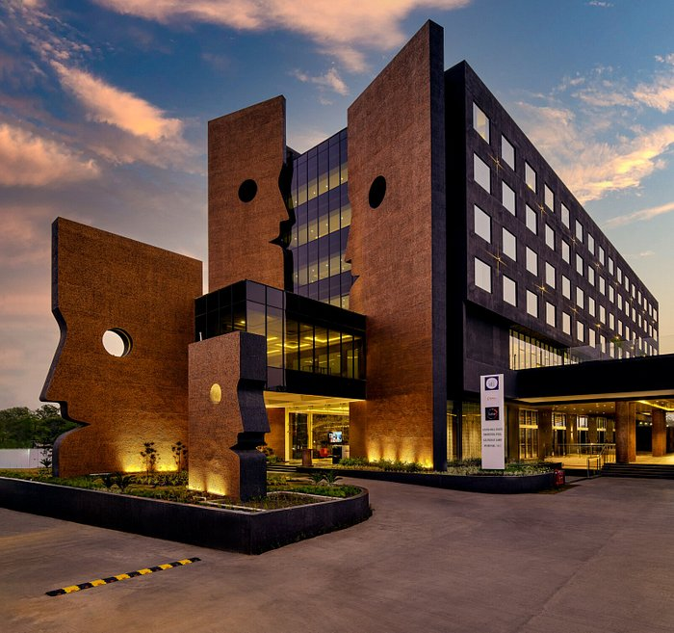
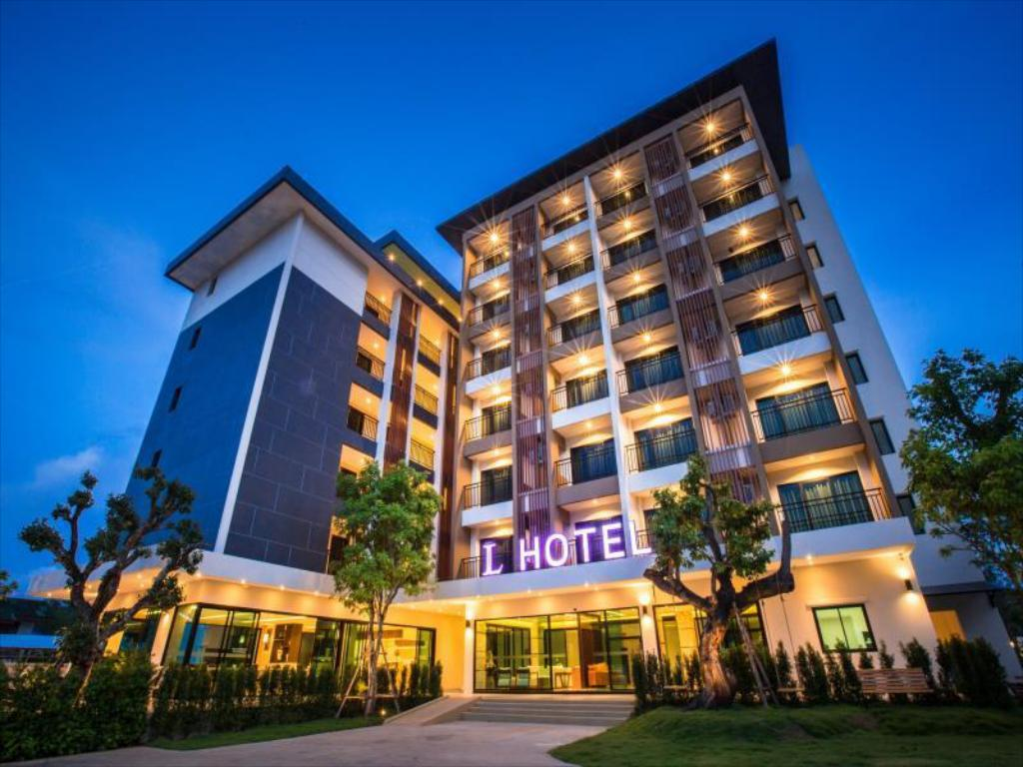
Problem statement
In recent years, City Hotel and Resort Hotel have seen HIGH CANCELLATION RATES. Each hotel is now dealing with number of issues as a result, including fewer revenues and less than ideal hotel room use. Consequently, lowering cancellation rates is both hotel’s primary goal in order to increase their efficiency in generating revenue, and for us to offer thorough business advice to address this problem

Slide 3
Assumptions
No unusual occurrences between 2015 and 2017 will have a substantial impact on the data used
The information is still current and can be used to analyse a hotel’s possible plans in efficient manner
There are no unanticipated negatives to the hotel employing any advised technique
The hotels are not currently using any of the suggested solutions
The biggest factor affecting the revenue is booking cancellations
Cancellations result in vacant rooms for the booked length of time
Clients make hotel reservations the same year they make cancellations

Slide 4

Research questions
What are the variables that affect hotel reservation cancellations?
How can we make hotel reservation cancellations better?
How will hotels be assisted in making pricing and promotional decisions?
More cancellations occur when price are higher
When there is a longer waiting list, customers tends to cancel more frequently.
The majority of clients are coming from offline travel agents to make their reservations

Slide 5
Analysis and findings

Slide 6
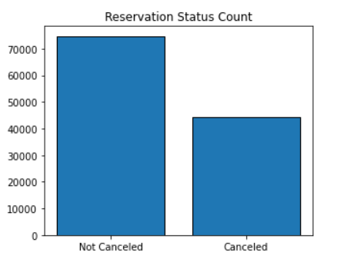
The above bar graph shows the % of reservations that are cancelled and that are not. It is obvious that there are still a significant number of reservations that have not been cancelled but there are still 37% o clients who cancelled their reservations, which has a significant impact on hotel’s earnings

Slide 7
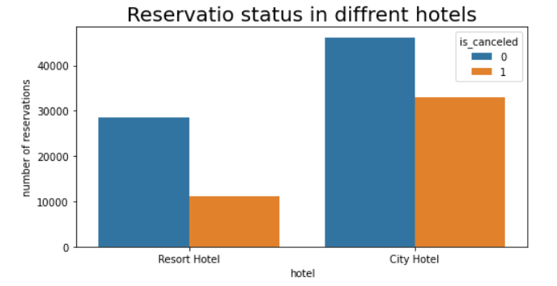
In comparison to resort hotels, city hotels have more bookings. It’s possible that resort hotels are more expensive than the city hotels

Slide 8
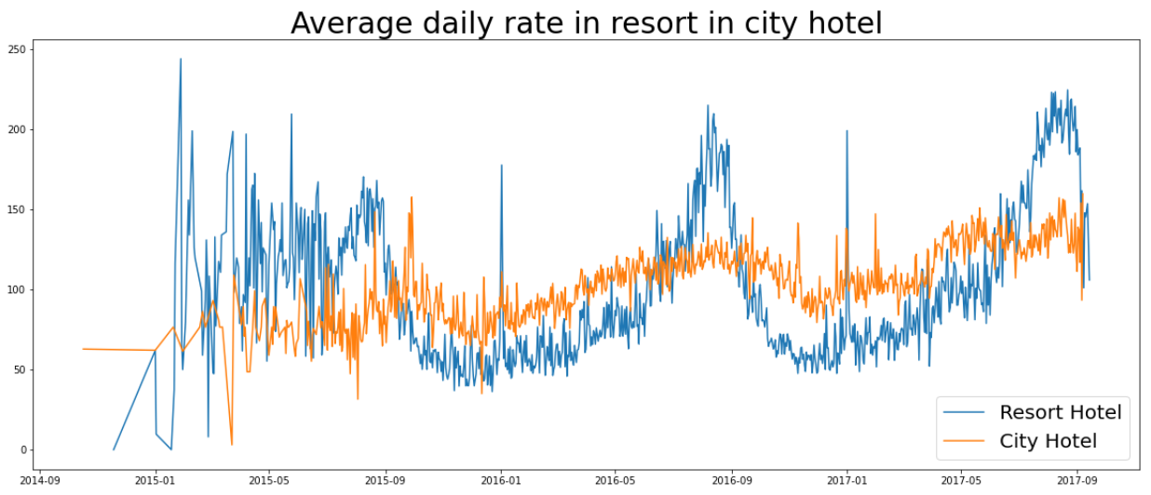
The line graph above shows that, on certain days, the average daily rate for a city hotel is less than that of a resort hotel, and on other days, it is even less. It goes without saying that weekend and holidays may see a rise in resort hotel rates

Slide 9
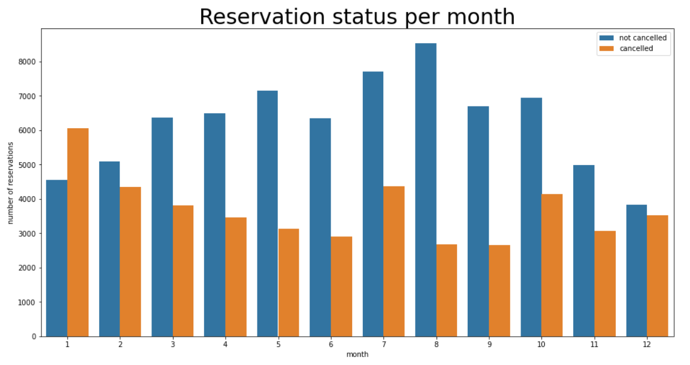
The above bar graph represents the highest and lowest reservation levels according to reservation status. As can be seen, both the number of confirmed reservations and the number of cancelled reservations are largest in month of august whereas January in the month with the most cancelled reservations

Slide 10
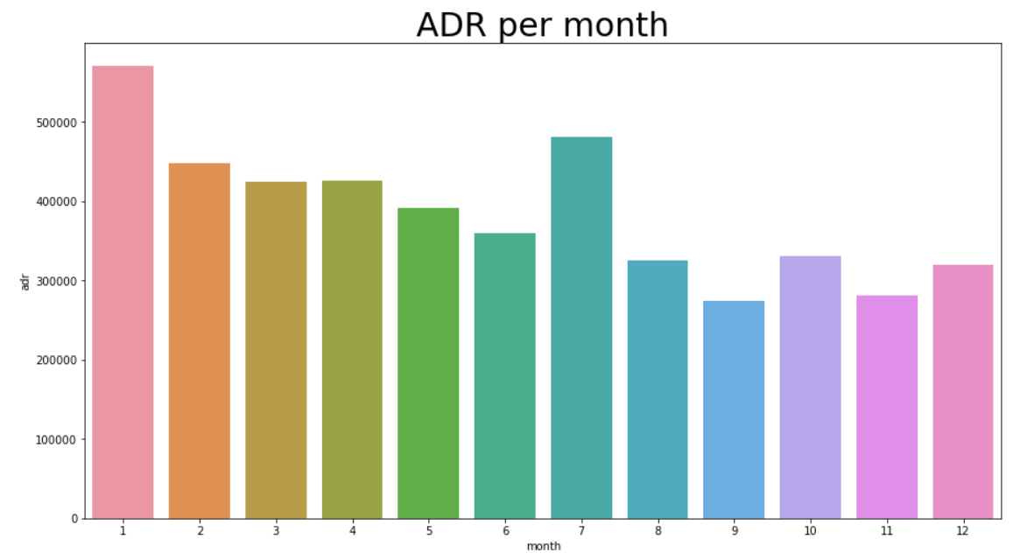
This bar graph represents that cancellation s are most common when prices are greatest and least common when they are lowest. Therefore, the cost of the accommodation is solely responsible for cancellation

Slide 11
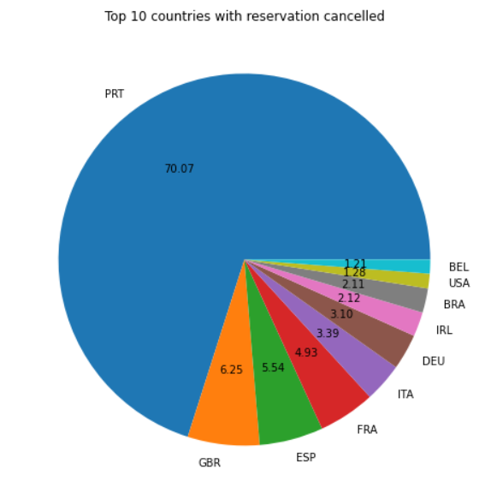
The top country is Portugal with most number of cancellations

Slide 12
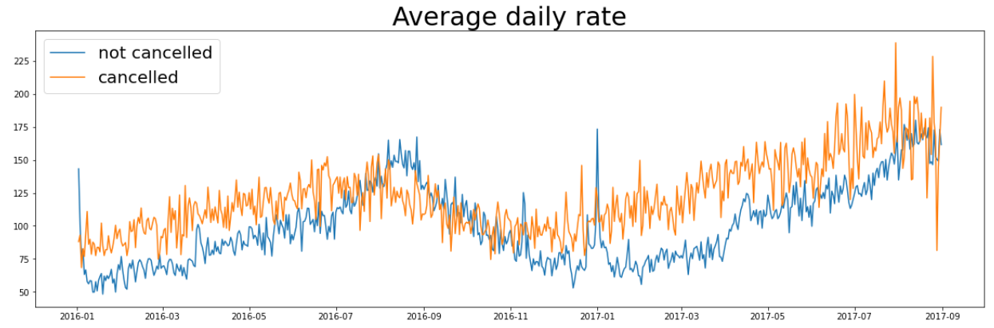
As seen in the graph, reservations are cancelled when the average daily rate is higher than when it is not cancelled. It clearly proves all the above analysis, that the higher prices leads to higher cancellation.

Slide 13
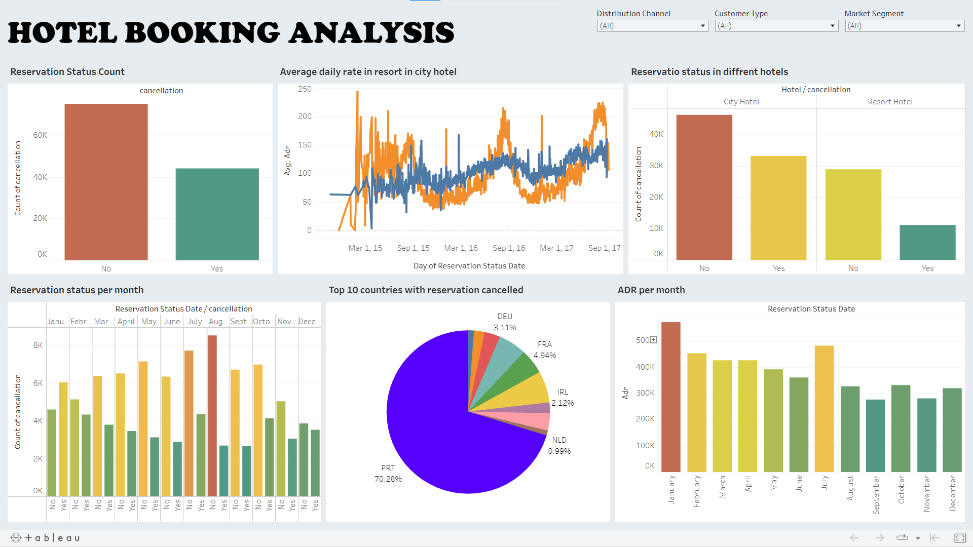
link

Slide 14
Suggestions
Cancellation rates rise as the price does. In order to prevent cancellations of reservations, hotels could work on their pricing strategies and try to lower the rates for specific hotels based on locations. They can also provide some discount to consumers.
As the ratio of the cancellation and not cancellation of the resort hotel is higher than city hotel, so the hotels should provide a reasonable discount on the room prices on weekend or on holidays.
In the month of January, hotels can start campaigns or marketing with a reasonable amount to increase their revenue as the cancellation is the highest in this month.
They can also increase the quality of their hotels and their services mainly in Portugal to reduce the cancellation rate

Slide 15
THANK YOU

